Slide 1
The Wheel of Life
Prepared by: the English teacher Laima Janonienė, Kėdainiai Sviesioji Gymnasium

Slide 2
We should firstly ask ourselves, why do we spend too much time on something?
The balance wheel of life is ?????
What do think?

Slide 3
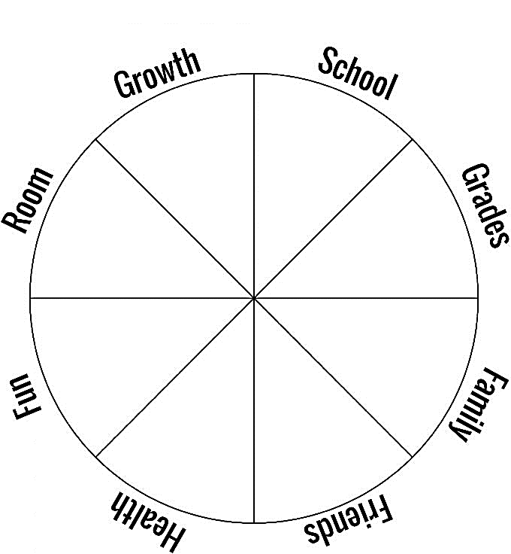
STEP 1: Wheel of Life
School: Your overall experience of being in class and being with your friends
Grades: How happy (or not) you are with your grades
Family: Usually your immediate family, and if you need to break this wedge into two (parents and siblings) that works
Friends: Pretty straight forward
Health: How healthy you feel, how much you exercise, and your diet
Fun: How much fun you are having
Room: How clean or messy your room is and how happy you are with it
Growth: How you feel you are growing personally and spiritually

Slide 4
STEP 2: Rate your current level of satisfaction on each of these areas.
EXAMPLE:
3
9
7
9
5
10
2
6

Slide 5
STEP 3: Ask yourself, “Why is that the number _____________ for?”
Growth:
Why?
School:
Why?
Grades:
Why?
Family:
Why?
Friends:
Why?
Health:
Why?
Fun:
Why?
Room:
Why?

Slide 6
STEP 4: Ask yourself, “How can I get a to a for each area?”
Growth: How?
School:
How?
Grades:
How?
Family:
How?
Friends:
How?
Health:
How?
Fun:
How?
Room:
How?

Slide 7
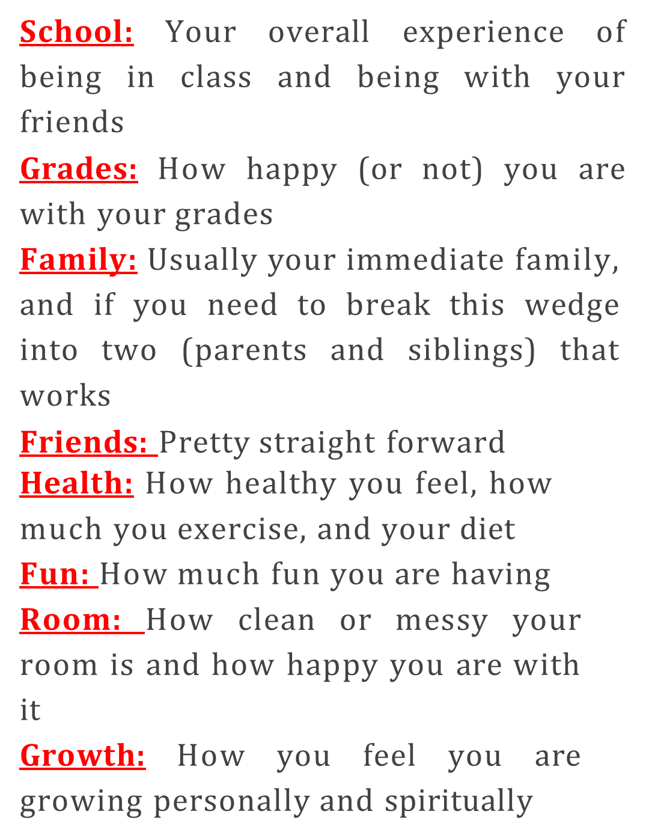
STEP 5: Save these sheets. Print this again at the beginning of next quarter and see the progress that you have made!

